Slide 1
The modern world is parallel
Multicore.
Networks.
Clouds of CPUs.
Loads of users.
When we cannot rely on the hardware improvements, the only way to go is more efficient software to increase the performance.
That's where concurrency comes in.

Slide 2
Parallelism is doing lots of things at the same time.
Concurrency is the capability to deal with lots of things at once.

Slide 3
Concurrency is about structure, parallelism is about execution.
Concurrency provides a way to structure a solution to solve a problem that may (but not necessarily) be parallelizable.
If concurrency is not parallelism.. Then what is it?

Slide 4
Rob pike’s video explaining concurrency
https://youtu.be/cN_DpYBzKso?t=262
4.25 – 13.17

Slide 5
Concurrency
Programming as the composition of independently executing processes.
Concurrency is about design
Design your program as a collection of independent processes
Design these processes to eventually run in parallel
Design your code so that the outcome is always the same
Concurrency in detail
• group code (and data) by identifying independent tasks
• no race conditions
• no deadlocks
• more workers = faster execution

Slide 6
Communicating Sequential Processes (CSP)
• Tony Hoare, 1978
Each process is built for sequential execution
2. Data is communicated between processes via channels. No shared state!
3. Scale by adding more of the same
Concurrency is a way to structure a program by breaking it into pieces that can be executed independently.
Communication is the means to coordinate the independent executions.
This is the Go model and (like Erlang and others) it's based on CSP:
C. A. R. Hoare: Communicating Sequential Processes (CACM 1978)

Slide 7
Go’s concurrency toolset
• go routines - concurrent execution
• channels - synchronization and messaging • select - multi-way concurrent control
• sync package

Slide 8
Most of those programming languages supports multi-threading.
But the real problem comes with concurrent execution, threading-locking, race conditions and deadlocks.
Those things make it hard to create a multi-threading application on those languages.
On the other hand, Go was released in 2009 when multi-core processors were already available. That’s why Go is built with keeping concurrency in mind. Go has goroutines instead of threads. They consume almost 2KB memory from the heap. So, you can spin millions of goroutines at any time.

Slide 9
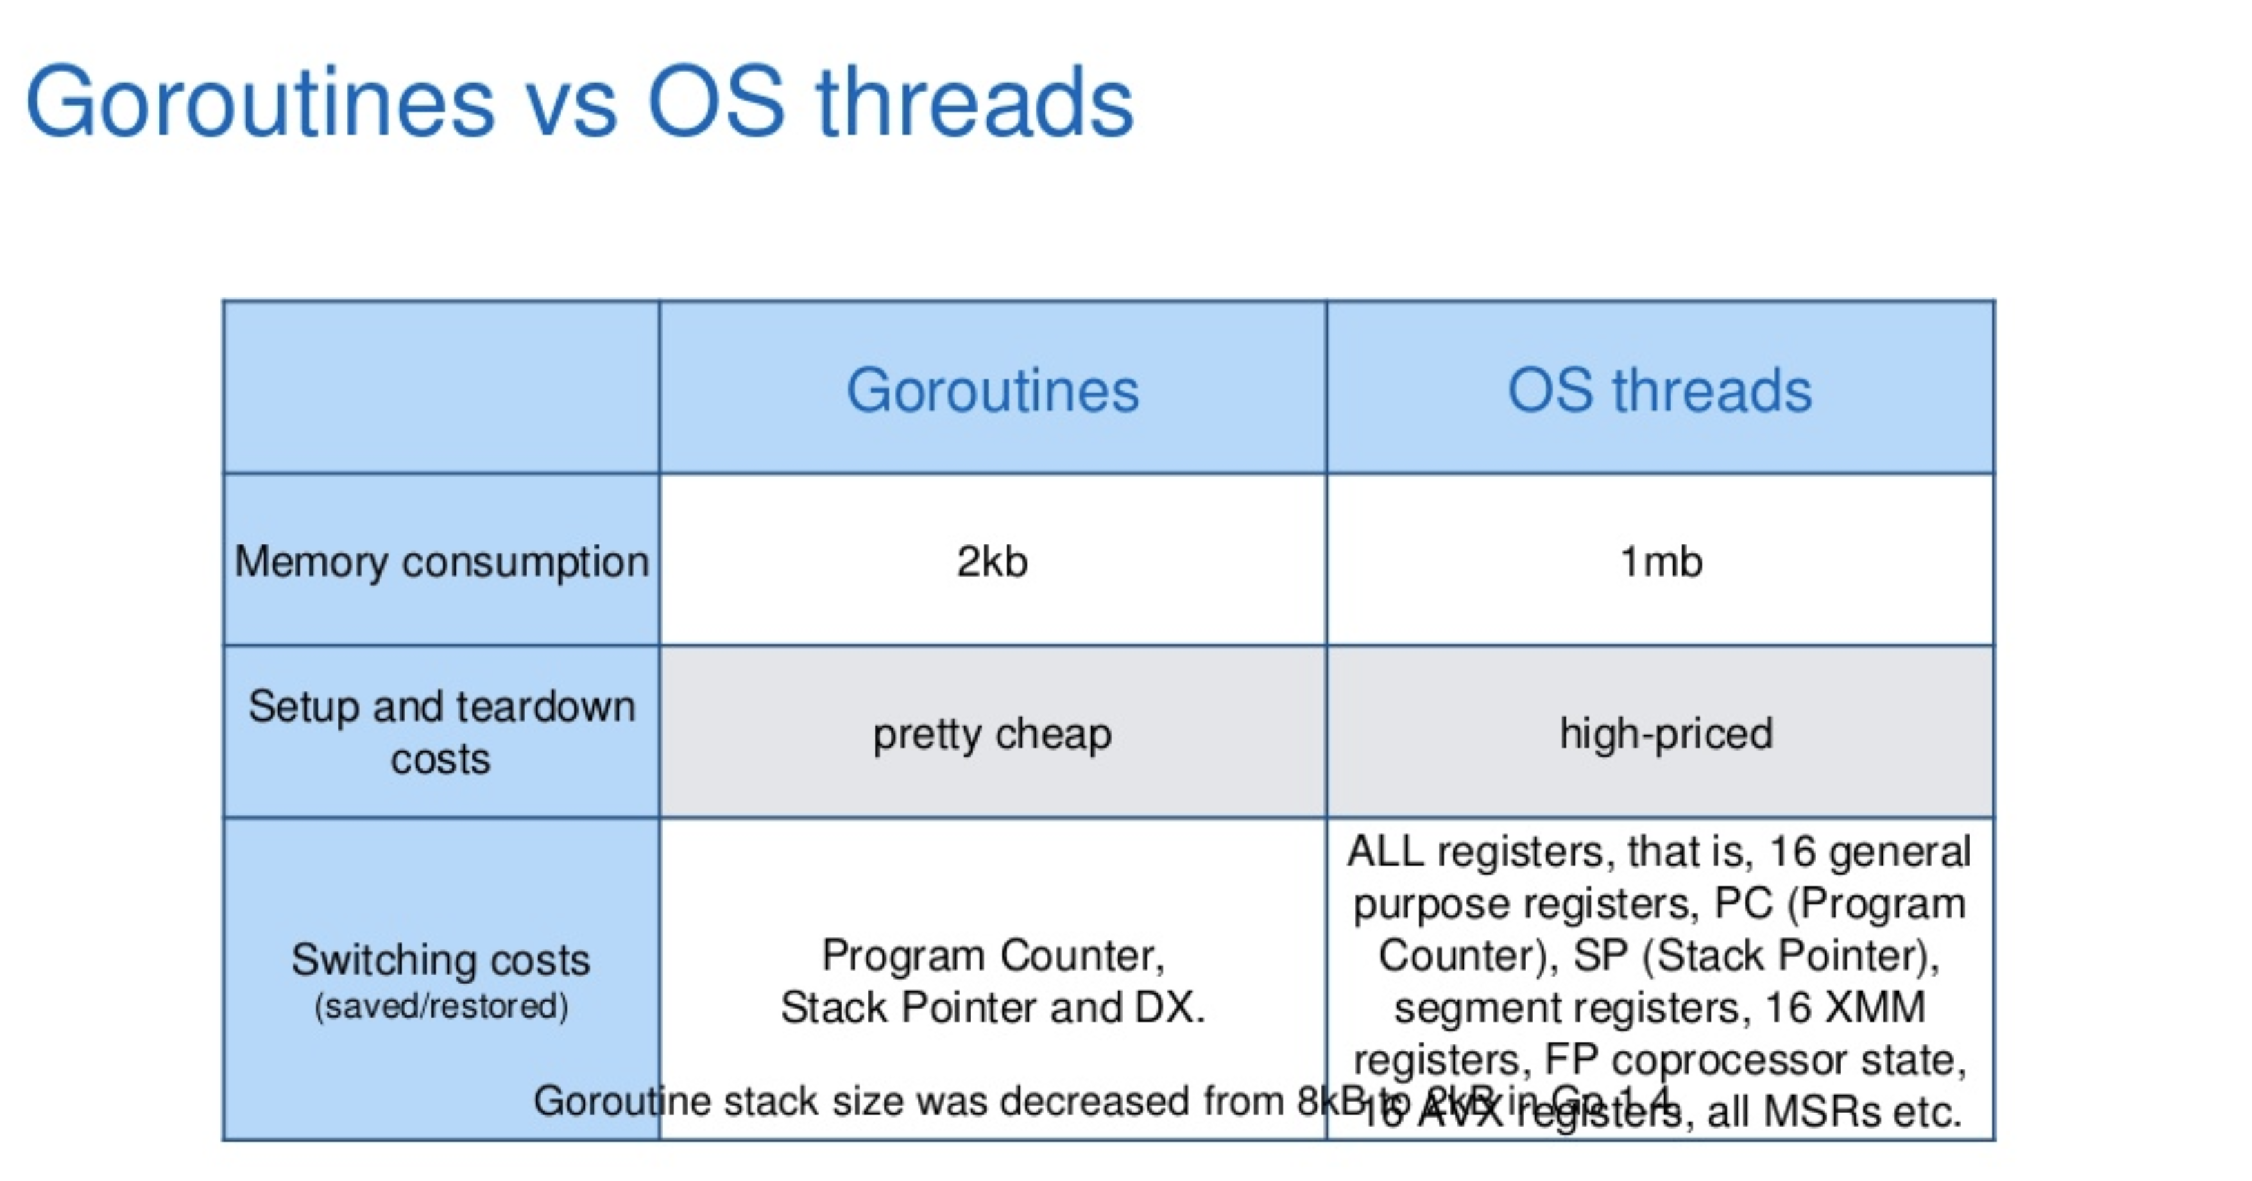

Slide 10
Advantages of Goroutines over threads
Goroutines are extremely cheap when compared to threads. They are only a few kb in stack size and the stack can grow and shrink according to needs of the application whereas in the case of threads the stack size has to be specified and is fixed.
The Goroutines are multiplexed to fewer number of OS threads. There might be only one thread in a program with thousands of Goroutines. If any Goroutine in that thread blocks say waiting for user input, then another OS thread is created and the remaining Goroutines are moved to the new OS thread. All these are taken care by the runtime and we as programmers are abstracted from these intricate details and are given a clean API to work with concurrency.
Goroutines communicate using channels. Channels by design prevent race conditions from happening when accessing shared memory using Goroutines. Channels can be thought of as a pipe using which Goroutines communicate. We will discuss channels in detail in the next tutorial.

Slide 11
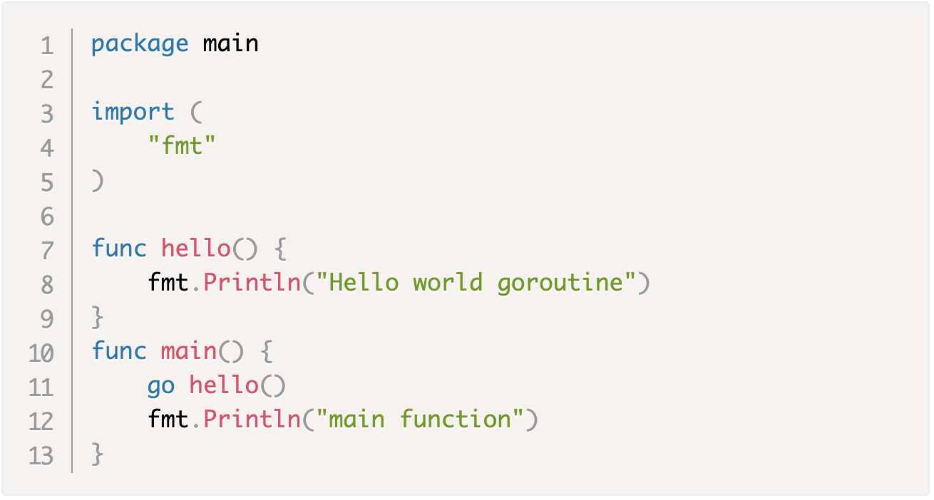
Lets create a Goroutine
https://play.golang.org/p/zC78_fc1Hn

Slide 12
When a new Goroutine is started, the goroutine call returns immediately. Unlike functions, the control does not wait for the Goroutine to finish executing. The control returns immediately to the next line of code after the Goroutine call and any return values from the Goroutine are ignored.
The main Goroutine should be running for any other Goroutines to run. If the main Goroutine terminates then the program will be terminated and no other Goroutine will run.
https://play.golang.org/p/U9ZZuSql8-

Slide 13
Multiple go routines - https://play.golang.org/p/oltn5nw0w3

Slide 14
The first portion of the image in blue color represents the numbers Goroutine, the second portion in maroon color represents the alphabets Goroutine, the third portion in green represents the main Goroutine and the final portion in black merges all the above three and shows us how the program works. The strings like 0 ms, 250 ms at the top of each box represent the time in milliseconds and the output is represented in the bottom of each box as 1, 2, 3 and so on. The blue box tells us that 1 is printed after 250 ms, 2 is printed after 500 ms and so on. The bottom of last black box has values 1 a 2 3 b 4 c 5 d e main terminated which is the output of the program as well. The image is self explanatory and you will be able to understand how the program works.

Slide 15
Sync
Async – fire and forget
Async – fire and ack
Async - fire and await
Async – fire dynamically multiple process and await

Slide 16
WaitGroup
A WaitGroup is used to wait for a collection of Goroutines to finish executing. The control is blocked until all Goroutines finish executing. Lets say we have 3 concurrently executing Goroutines spawned from the main Goroutine. The main Goroutines needs to wait for the 3 other Goroutines to finish before terminating. This can be accomplished using WaitGroup.
https://a5dd1af7-b0b5-4d3d-a241-9d74ff70652b.ws-ap0.gitpod.io/#/workspace/cde-golang

Slide 17
On success and failure wg.done
Add to increment

Slide 18
The case study
Single threaded applications

Slide 19
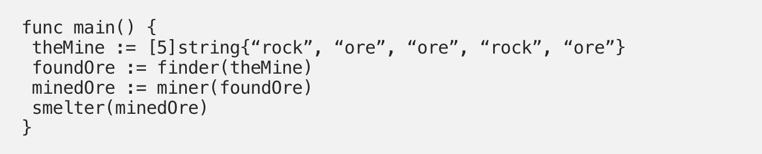
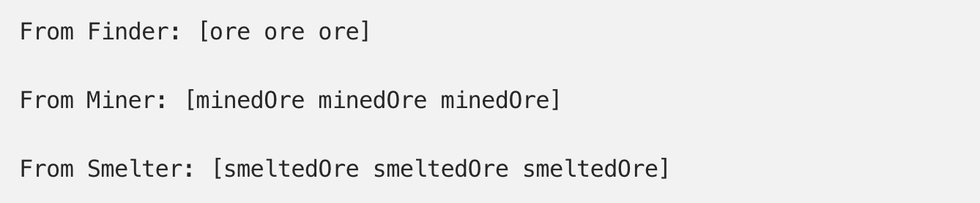

Slide 20
channels
Channels can be thought as pipes using which Goroutines communicate. Similar to how water flows from one end to another in a pipe, data can be sent from one end and received from the another end using channels.

Slide 21
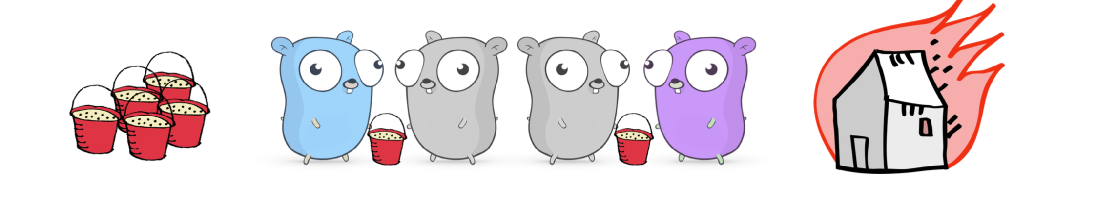

Slide 22
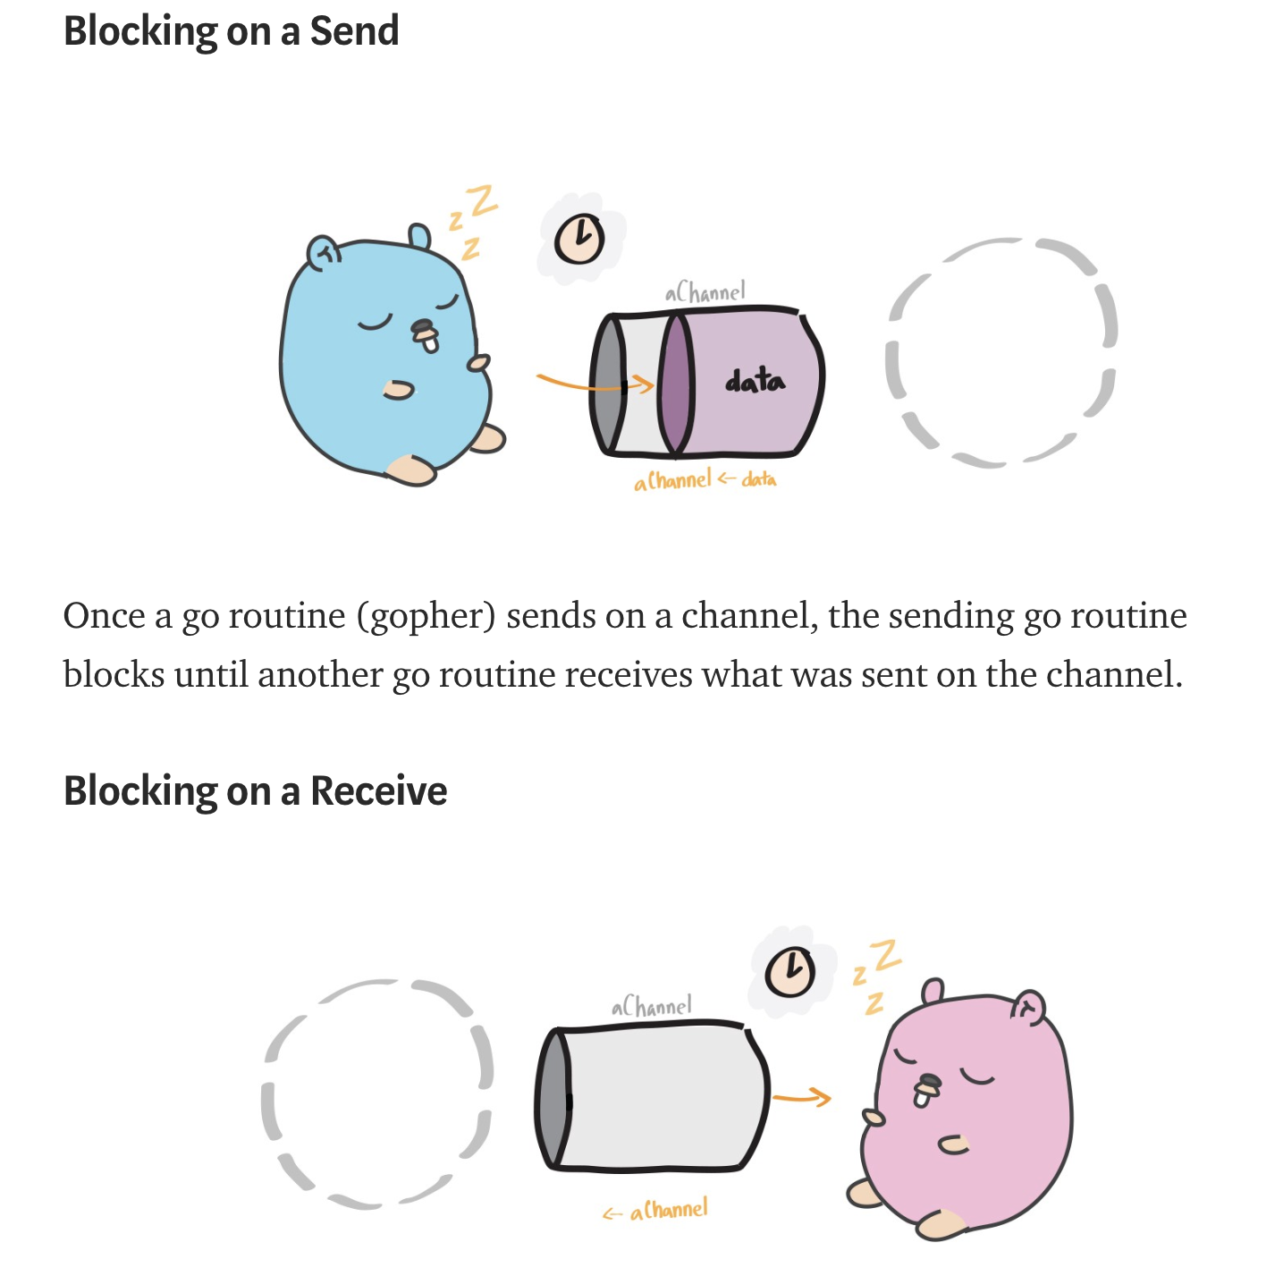
Blocking

Slide 23
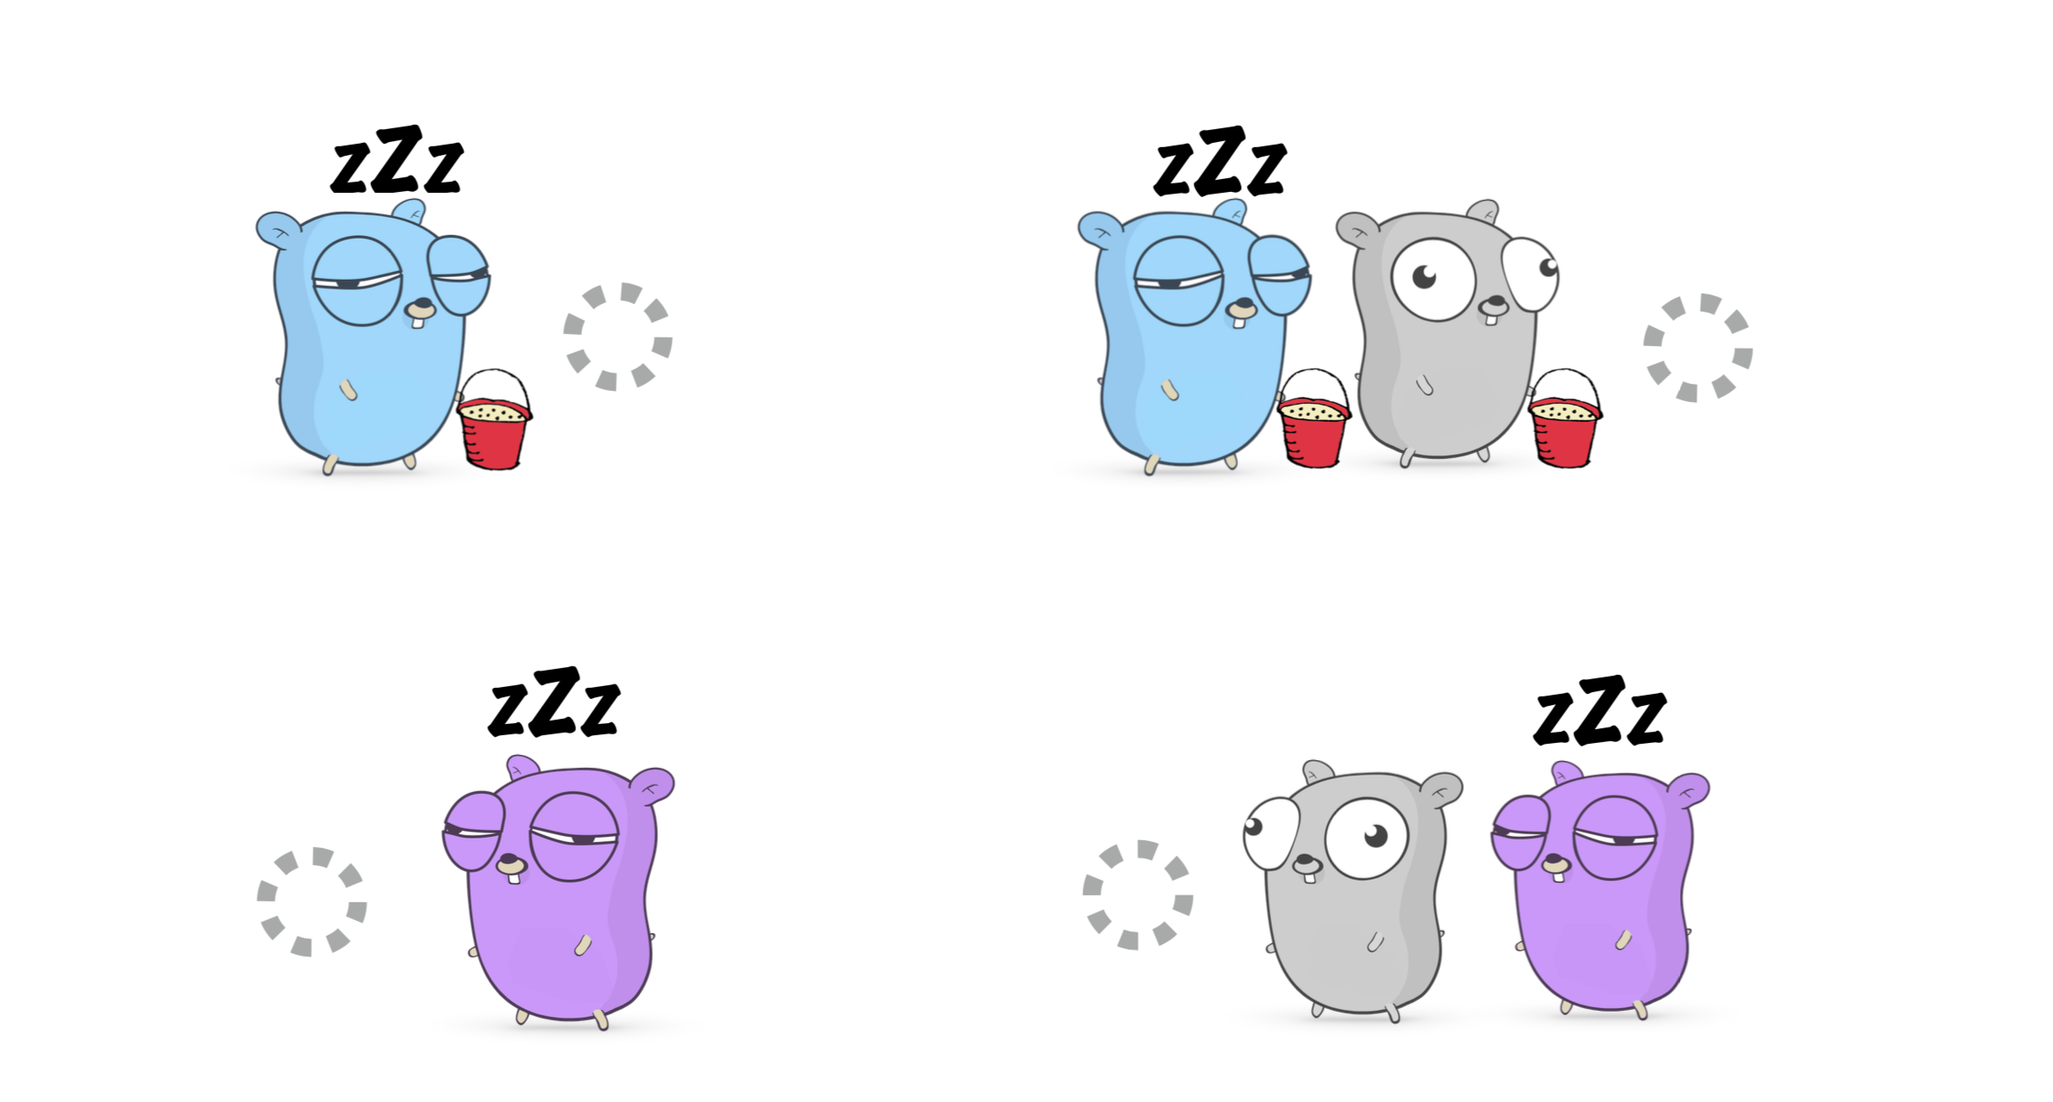
https://youtu.be/rDRa23k70CU?t=301 – until 11.30

Slide 24
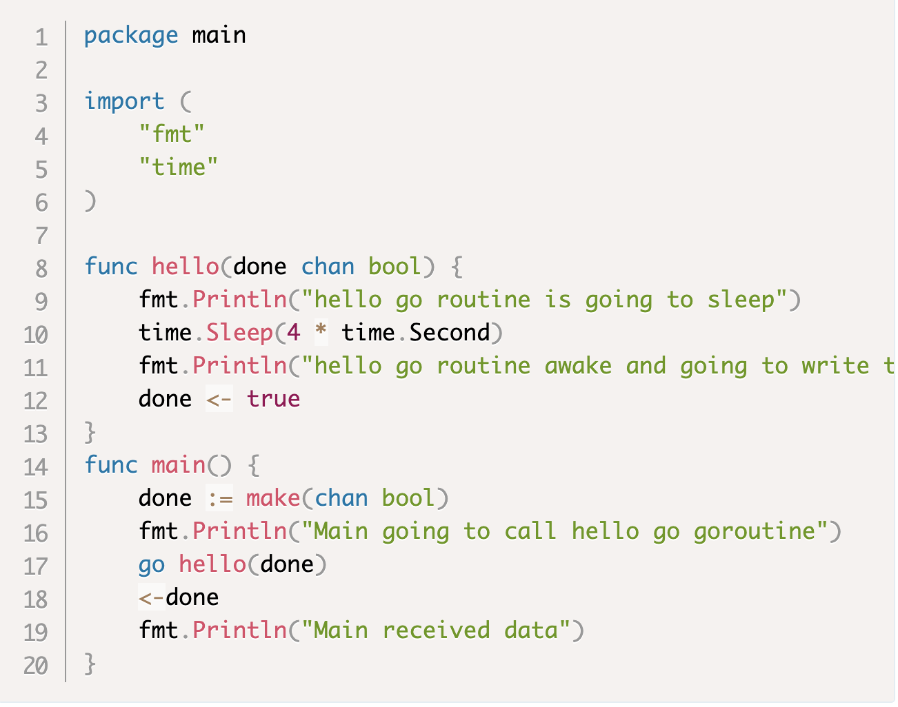
Sending and receiving from channel
Unidirectional channels

Slide 25
What are buffered channels?
buffered
unbuffered

Slide 27
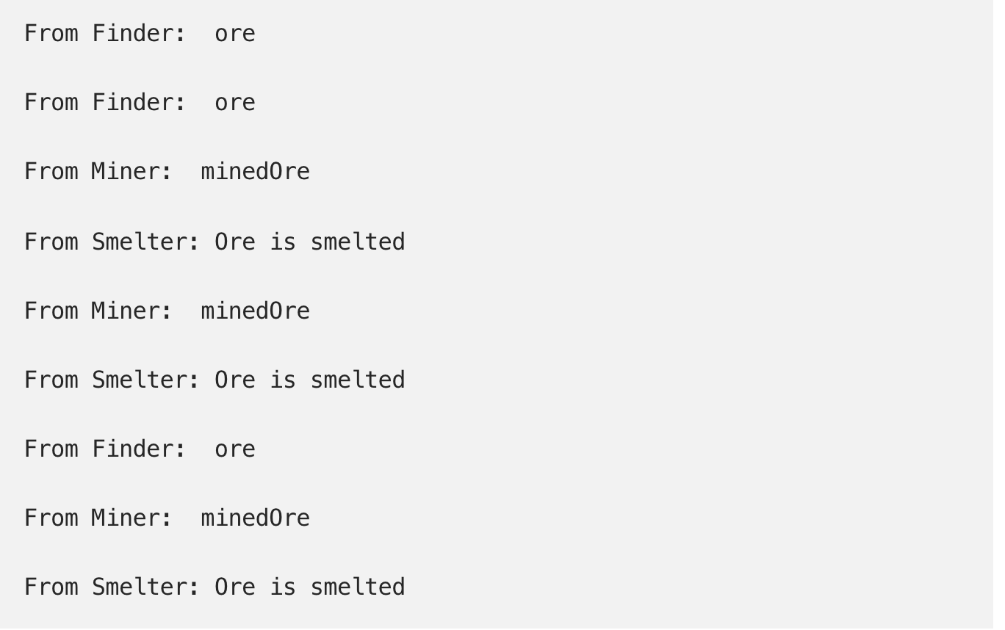
https://play.golang.org/p/JO7ZlCiX_Vu

Slide 28
https://play.golang.org/p/Vk273X73cDp
Miner app

Slide 29
select

Slide 30
Mutex

Slide 31
Worker Pool Implementation

Slide 32
Go intentionally leaves out many features of modern OOP languages.
No classes. Every thing is divided into packages only. Go has only structs instead of classes.
Does not support inheritance. That will make code easy to modify. In other languages like Java/Python, if the class ABC inherits class XYZ and you make some changes in class XYZ, then that may produce some side effects in other classes that inherit XYZ. By removing inheritance, Go makes it easy to understand the code also (as there is no super class to look at while looking at a piece of code).
No constructors.
No annotations.
No generics.
No exceptions.
Above changes make Go very different from other languages and it makes programming in Go different from others.

